Slide 1

Class 01 Introductions Monday, August 24
INFO 3401: Information Explorations
Abe Handler & Brian Keegan abram.handler@colorado.edu brian.keegan@colorado.edu

Slide 2
Agenda
Pre-class:
Course design, overview, requirements
A brief history of data science
Building a data scientist mindset
In-class:
Introductions
Zoom norms
Course design input/questions
Mindset exercise

Slide 3
Course Overview

Slide 4
Why Are You Here?
INFO 1201
INFO 2201
INFO 3401
INFO 3402
INFO 1301
INFO 2301
Integrating concepts and skills from the rest of the computational and quantitative track
Improve your confidence analyzing diverse kinds of data
Develop your ability to match questions, data, and solutions
Understand professional data science tools and methods
Think critically about the opportunities and limitations of data

Slide 5
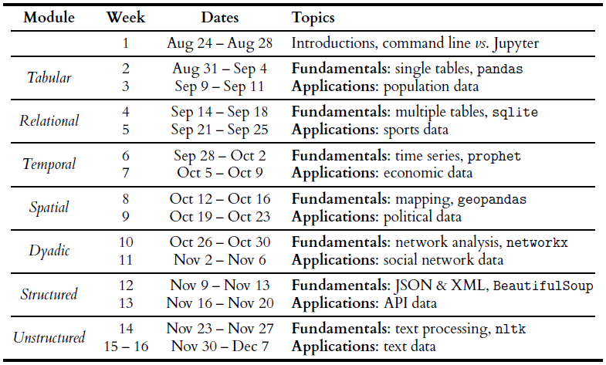







Course Overview
There
will be
class on the Monday and Wednesday of Thanksgiving week

Slide 6
Course Design
Seven two-week modules about different kinds of data
Tabular, relational, temporal, spatial, dyadic, structured, and unstructured
First week – Fundamentals – “what, why, and how” of this kind of data
Second week – Applications – “who, where, and when” of this kind of data
Flipped and synchronous remote classroom
Pre-recorded lectures on Canvas should be watched before class
Meeting on Zoom Mondays, Wednesdays, Fridays, 10:20 – 11:10
Attendance is required, will be taken, and is part of your grade
Whatever we announce by Canvas or in lecture overrides the syllabus
Thanks to Professor Danielle Albers Szafir developing many materials from previous versions!

Slide 7
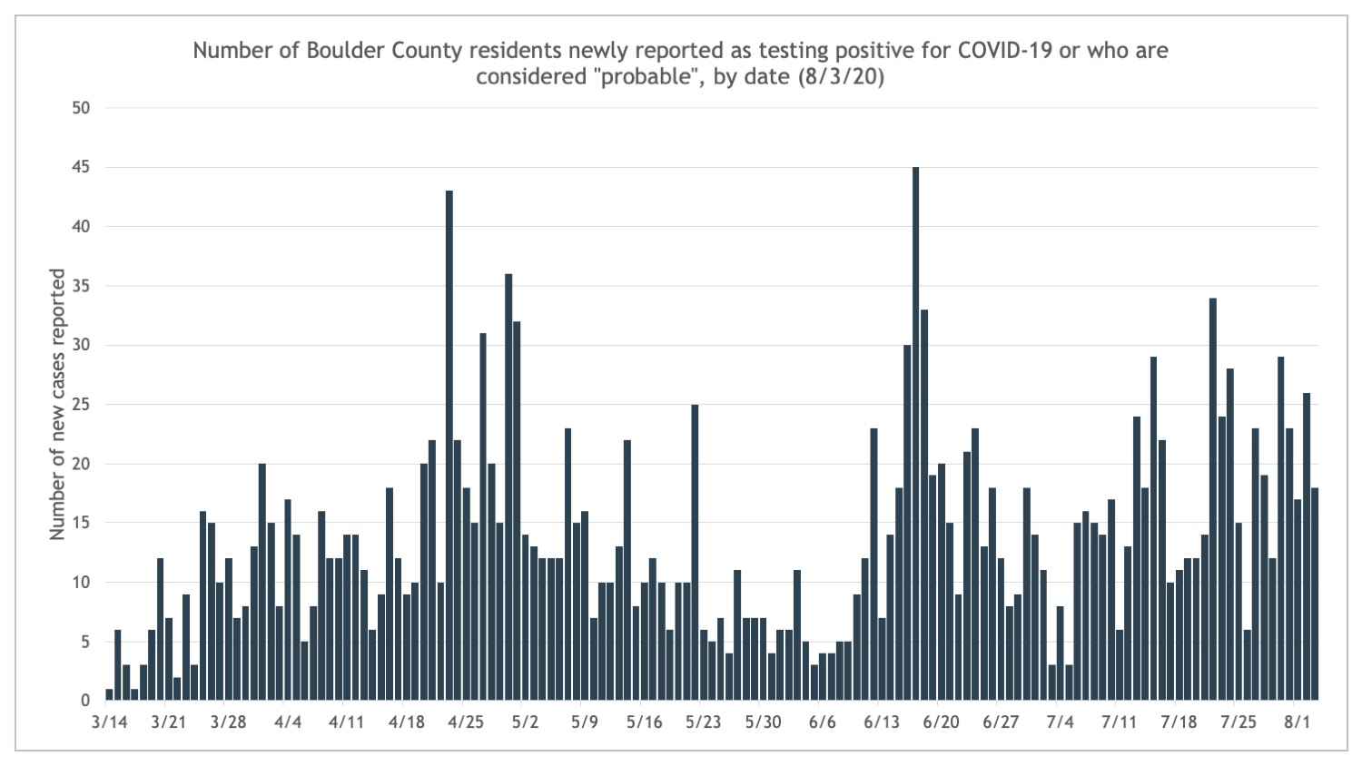
COVID-19 Contingencies
While MyCUInfo says the class meets MWF in Case W262, we will meet remotely for first 5 weeks
Class will be remote (Zoom) from Aug 24 through Sep 25
If Boulder County case rates are <12 new cases for >7 of the previous 14 days, we will consider moving to a “hybrid” model with some on-campus attendance
What a hybrid model looks like and how it works is something for all of us to discuss as a class
Campus policies for protection, hygiene, and conduct will be enforced (no mask, no class)

Slide 8

COVID-19 Contingencies
If you require sequestration, treatment, convalescence:
We will try to accommodate through extensions and incompletes
If a roommate, partner, or family member’s diagnosis will affect you:
We will also try to accommodate through extensions and incompletes
We are bound by and will enforce campus COVID-19 policy
Do not ghost us! Notify us as soon as possible of diagnoses or events that will impact your ability to participate in class so we can accommodate without end-of-term scrambling.

Slide 9
Flipped and Remote Classroom
Step 1: Watch the pre-recorded lecture posted to Canvas before class
No more than 50 minutes long, sometimes with exercises for you to do before class
Step 2: Log in to Zoom from 10:20am – 11:10am on Mondays, Wednesdays, and Fridays
Using class time for activities, discussions, experiments, guest lectures
Step 3: Complete assigned readings before Friday quiz deadline
Quizzes are a low-stakes but extrinsic motivator for you to keep up with readings and lectures
“Doesn’t this mean we have to spend twice as much in lecture?”
No, it means you have fewer readings and we’re making the most of valuable class time together.
“What’s the point of watching pre-recorded lectures if I can’t ask questions?”
The in-class activities will be designed to explore questions, ideas, and skills from pre-recorded lectures.

Slide 10
Evaluation
Module Assignments – 40% – Due the Wednesday after the module ends by 10am
Module Assignment 0 due September 2
Weekly Quizzes – 20% – Due every Friday afternoon by 5pm
Yes, including this Friday
Two lowest quiz grades automatically dropped
Participation – 20% – Attendance and engagement with in-class activities
Five classes can be missed without penalty
Final Project – 20% – More details and rolling deadlines through the semester
All assignments and quizzes will occur on Canvas, please do not attempt to submit via email

Slide 11
Computing Requirements
All code will be delivered using Jupyter Notebooks in Anaconda/Python
If you have never used these before or have a new computer: download it
If you have used these before, you’ll need to update: see Wednesday’s lecture
If you are a die-hard R, Julia, Matlab, etc. user: you are welcome to use, but no support will be provided
If you want to use Excel, Tableau, PowerBI, etc.: you can’t, confident coding is a basic INFO competency
Readings and lectures will be posted to Canvas: https://canvas.colorado.edu/courses/62560
If you don’t watch the lectures, you won’t pass the weekly quizzes
Class will meet via Zoom: https://cuboulder.zoom.us/j/98569655581
If you don’t attend class, you won’t receive participation credit
If you do not have reliable access to a computer to access Anaconda, Canvas, and Zoom: please contact the instructors immediate to work out an accommodation

Slide 12
A (Brief) Overview of Data Science

Slide 13
Readings
Required – expect to be on a quiz
PDFs of full books on Canvas – these are very short blog-length chapters.
Leek, J. (2015). The Elements of Data Analytic Style. Chapters 1, 2.
Peng, R.D. & Matsui, E. (2018). The Art of Data Science. Chapters 1, 2, 3.
Wilcom, “A Beginner’s Guide to Using Developer Documentation Like a Pro.”
Optional – won’t be on a quiz but may be a part of lecture, class, notebooks, etc.
Tukey, J.W. (1962). “The Future of Data Analysis.” Annals of Mathematical Statistics.
Cleveland, W.S. (2001). “Data science: An action plan for expanding the technical areas of the field of statistics.” International Statistical Review.
Tufte, E. (2016). “The Future of Data Analysis.” Microsoft Machine Learning & Data Science Summit.
Donoho, D. (2017). “50 Years of Data Science.” J. of Computational and Graphical Statistics.
McNichol, D. (2017). “The Many Futures of Data Analysis.” Towards Data Science.

Slide 14
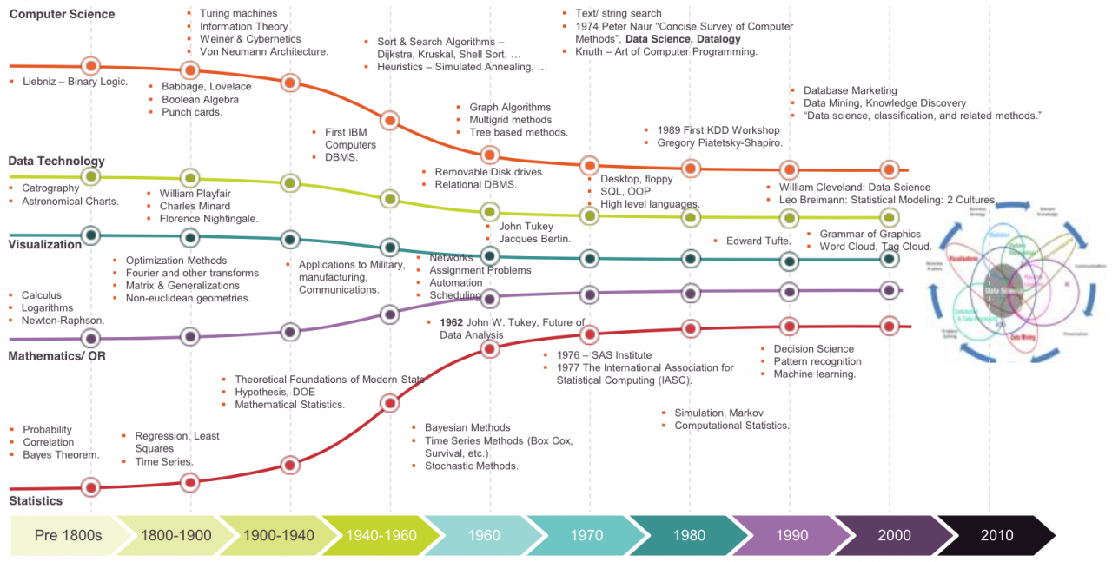
Standing on the shoulders of giants
Walker, M. (2018). “History of Data Science.” Data Science Association blog.

Slide 15

Statistics
Census used since antiquity for military drafts, taxation, apportionment
Collecting and tabulating data was an enormous and expensive process
John Graunt’s analysis of bills of mortality in 1662 is an early example of quantitative epidemiology and demography
“Statistics” emerged in 1700s for collecting demographic and economic data
Literally, “science of the state”: status (la) → statista (it) → statistik (de) → statistics (en)
Tied to transformations like nation-state, democracy, capitalism, industrial revolution
Creating institutions and practices for systematic data collection and analysis
Developments of probability, uncertainty, optimization, correlation, sampling, induction, and experiments in 1800s lead to modern statistics
Computing transforms collection, storage, retrieval, analysis, visualization of data
But math, statistics, and CS academic disciplines ignored each other for decades…
Stigler, S.M. (2002). Statistics on the Table.; Porter, T.M. (1988). The Rise of Statistical Thinking.; Desrosières, A. (2002). The Politics of Large Numbers.; Scott, J.C. (1998). Seeing Like a State.

Slide 16
Social Statistics and Democracy
Democracy requires numbers for its proper functioning
There is social statistics infrastructure
The Census is the bedrock of this infrastructure in the U.S. discontinuity
Sullivan, T. (2020). Coming To Our Census: How Social Statistics Underpin Our Democracy. Harvard Data Science Review.

Slide 17
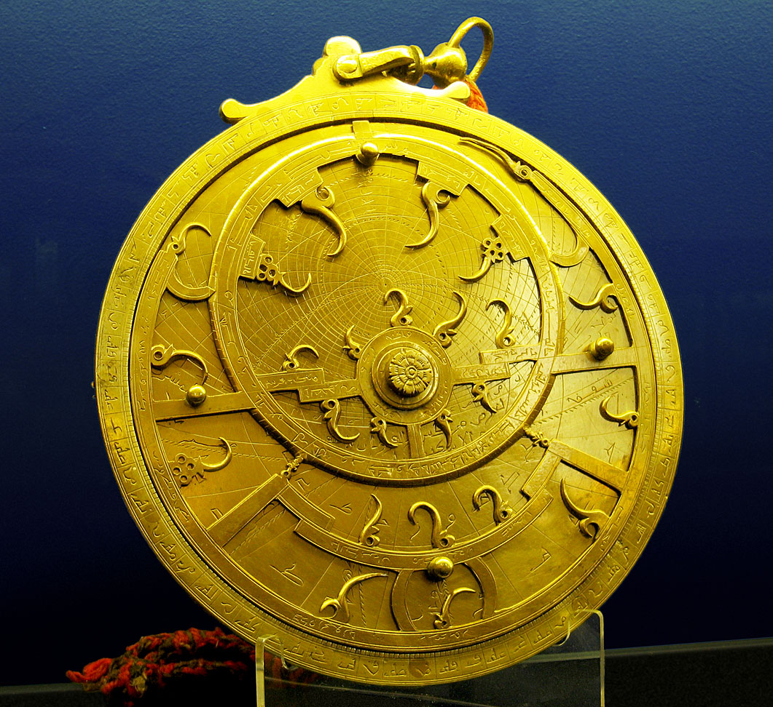
Computer Science
Astrolabes used in antiquity to predict eclipses and astronomical events
Mathematical and technological developments in 17-18C using binary logic
Boolean logic allowed complex operations from binary elements
Jacquard loom, punched cards used abstraction and algorithms for automation
Through 1950s, “computers” were (female) clerks performing calculations
Solving complex equations for WW1, WW2, & Space Race [Light 1999; Grieg 2005]
Babbage, Lovelace, Turing, Shannon, von Neumann, Weiner, et al.
Theoretical and technical breakthroughs before 1950 are still used today
“But is CS really a science? Isn’t it more applied like engineering?”
Algorithmic processes for describing and transforming information [Denning 2005]
Light, J.S. (1999). When Computers Were Women. Technology & Culture; Grieg, D.A. (2005). When Computers Were Human; Denning, P.J. (2005). Is Computer Science Science? CACM.

Slide 18
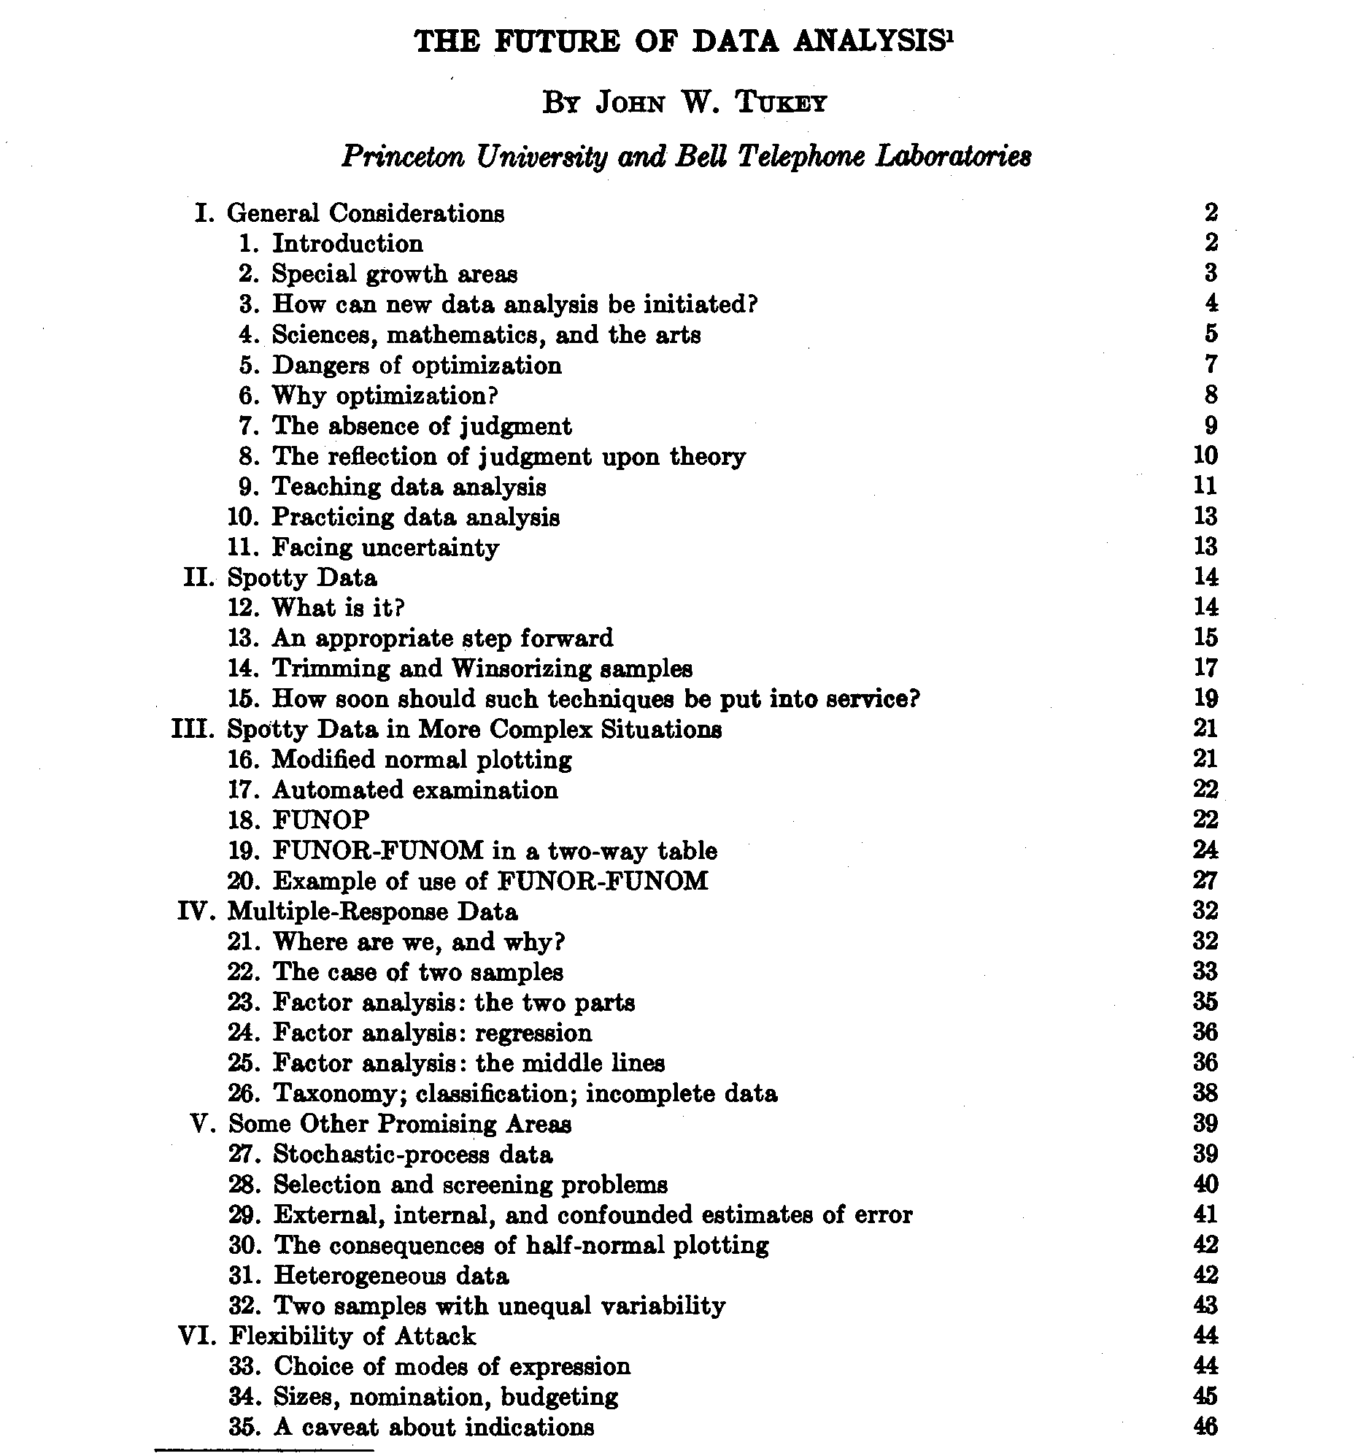
Tukey (1962) The Future of Data Analysis
“my central interest is in data analysis, which I take to include, among other things: procedures for analyzing data, techniques for interpreting the results of such procedures, ways of planning the gathering of data to make its analysis easier, more precise or more accurate, and all the machinery and results of (mathematical) statistics which apply to analyzing data … data analysis is a very difficult field. It must adapt itself to what people can and need to do with data. In the sense that biology is more complex than physics, and the behavioral sciences are more complex than either, it is likely that the general problems of data analysis are more complex than those of all three.”

Slide 19


Data Mining Becomes a Street Fight
1974: Peter Naur offers the first definition of “data science”
“The science of dealing with data… while the relation of the data to what they represent is delegated to other fields and sciences.”
1970s-80s: Introduction of SQL syntax and relational database models
1989: First workshop on “knowledge discovery in database systems”
1994: First BusinessWeek cover on how companies are using data
1997: Jeff Wu calls for statistics to be renamed data science
2001: William Cleveland publishes his “Data Science Action Plan”
Collaboration, statistical model building, computing technologies, education and training, tool development and use, mathematical theories
2003: Michael Lewis publishes Moneyball
Organizations everywhere realize analytics will disrupt everything [Davenport 2006]
Davenport, T.H. Competing on Analytics. HBR.; Press, G. (2013). A Very Short History of Data Science. Forbes.; Li, R. (2016). History of Data Mining. KDnuggets.

Slide 20
Sexy Data Scientists and Big Data
2005 – now: Federal government reports emphasize importance of supporting data science
Data is sexy?
Hal Varian: “the sexy job in the next ten years will be statisticians.” (2009)
HBR: “data scientist is the sexiest job of the 21st century” (2012)
2010 – 2016: huge volumes of data being generated need specialized analytics infrastructures
Hadoop, Spark, Hive, AWS, Azure, pipelines, lakes, etc.
This class will use “medium data” → bigger than what Excel can handle but it still fits into memory
2016 – present: social good; fairness, accountability, transparency, ethics (FATE); human-centered
It turns out that data science can be used for not-so-good purposes; need to design “good” in

Slide 21
Data-centered vs. Human-centered
Do you care more about the data or the people?
>90% of data science education focuses on data-centered perspectives
 | Data-centered | Human-centered
Who | Unicorn expert-hacker-engineer | Anyone with a question
What | How to do data science | How to be a data scientist
Where | CS, stats, math | INFO, social sciences, real world
When | On the job | As a citizen
Why | Because data can help something | Because data can help someone
How | Life-cycles, frameworks, processes | Context, participation, responsibility

Slide 22
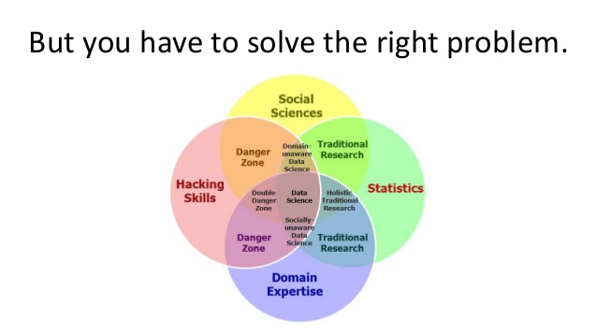
Real Data Scientists Use Venn Diagrams
Tunkelang, D. Data Science: A Mindset for Productivity.

Slide 23
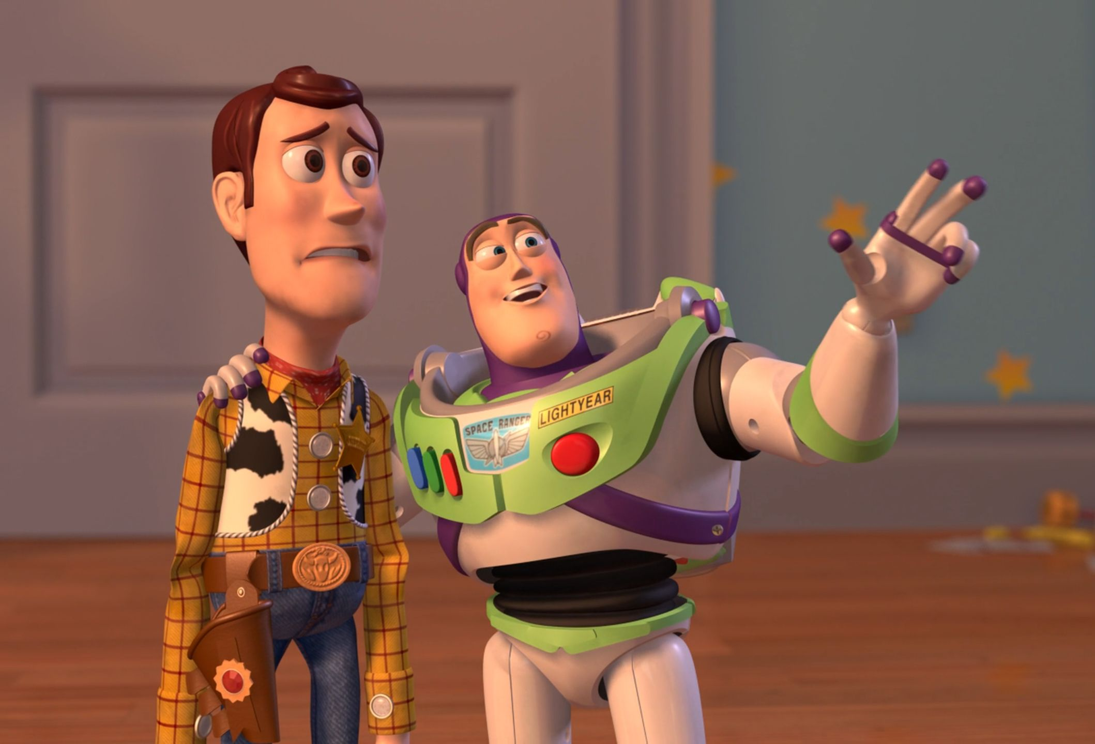
…and flow charts
FLOW CHARTS
FLOW CHARTS EVERYWHERE

Slide 24

CRISP-DM
Cross-industry standard process for data mining

Slide 25
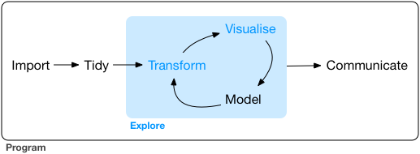
Data Exploration Life-cycle
Wickham, H. & Grolemund, G. (2017). R for Data Science.

Slide 26
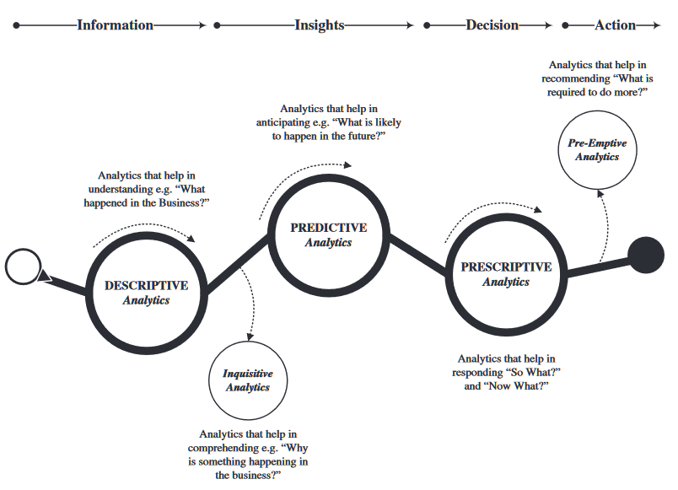
Types of Analytics
Sivarajah, U., Kamal, M. M., Irani, Z., & Weerakkody, V. (2017). Critical analysis of Big Data challenges and analytical methods. Journal of Business Research, 70, 263-286.

Slide 27
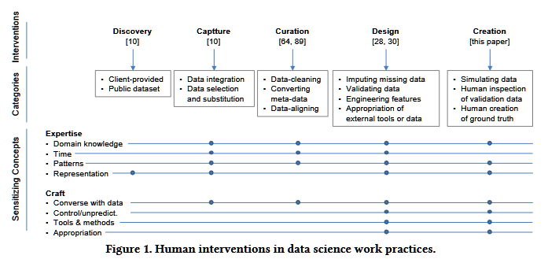
How Data Scientists Work with Data
Muller, M., ... & Erickson, T. (2019). How data science workers work with data: Discovery, capture, curation, design, creation. In Proc. CHI 2019.

Slide 28
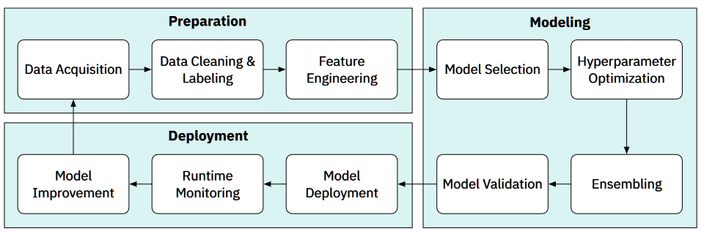
Data Science Workflows
Zhang, A. X., Muller, M., & Wang, D. (2020). How do data science workers collaborate? roles, workflows, and tools. PACM CSCW.

Slide 29
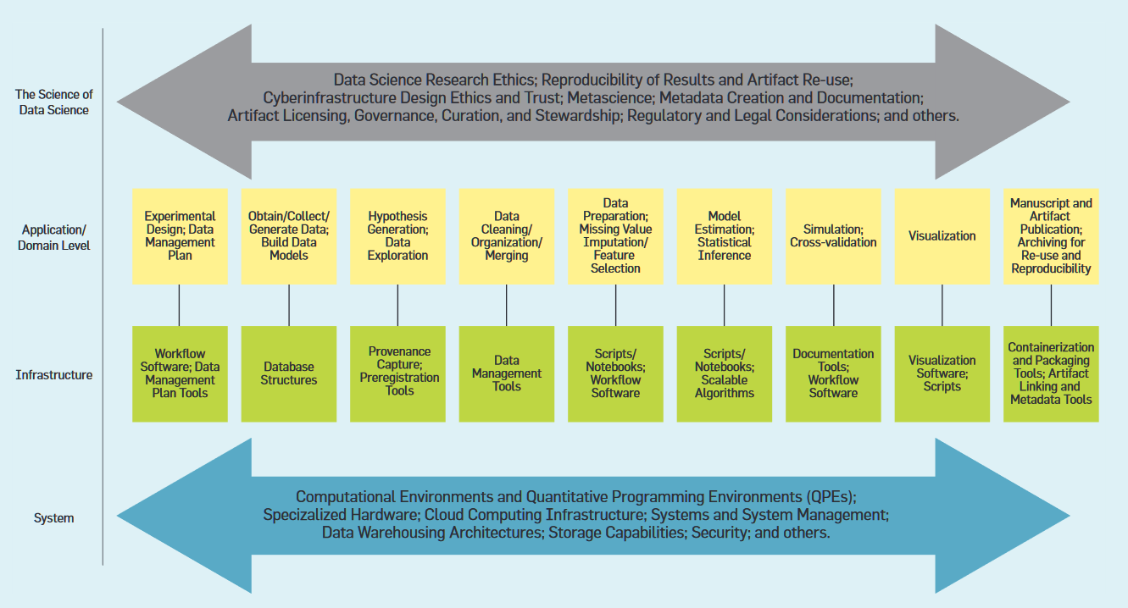
Another Data Science Life-cycle
Stodden, V. (2020). The data science life cycle: A disciplined approach to advancing data science as a science. Communications of the ACM, 63(7), 58–66.

Slide 30
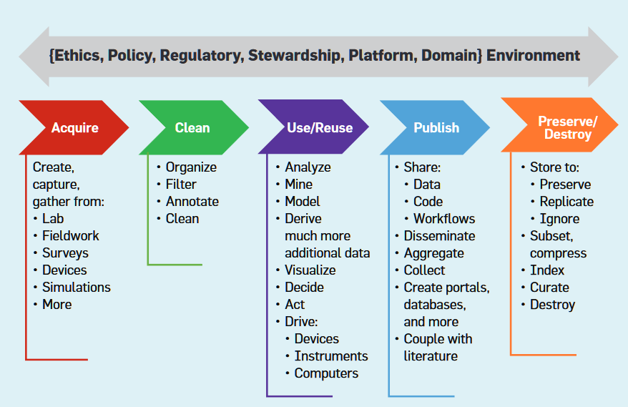
Yet Another Data Life-cycle
Stodden, V. (2020). The data science life cycle: A disciplined approach to advancing data science as a science. Communications of the ACM, 63(7), 58–66.

Slide 31
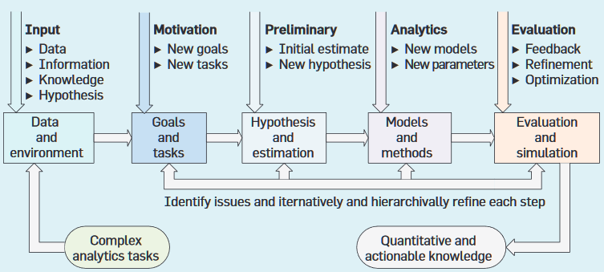
Still Another Data Life-cycle
Cao, L. (2017). Data science: Challenges and directions. Communications of the ACM, 60(8), 59–68.

Slide 32
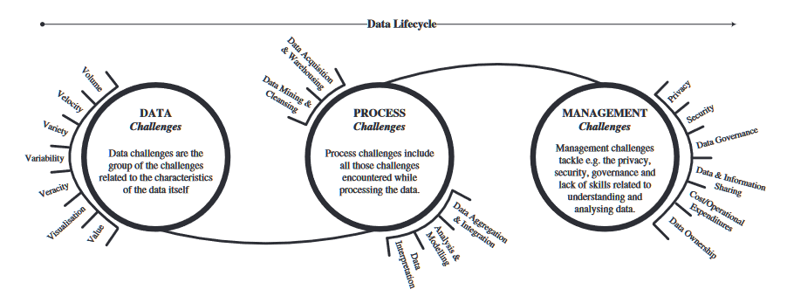
Challenges in the Data Life-cycle
Sivarajah, U., Kamal, M. M., Irani, Z., & Weerakkody, V. (2017). Critical analysis of Big Data challenges and analytical methods. Journal of Business Research, 70, 263-286.

Slide 33
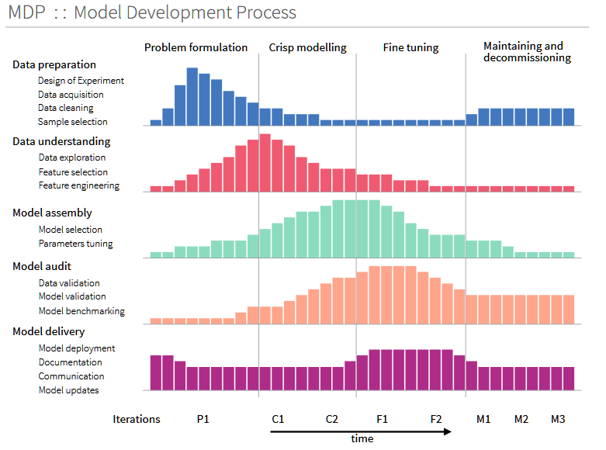
Data Science Model Development
Biecek, P. (2019). Model Development Process.

Slide 34
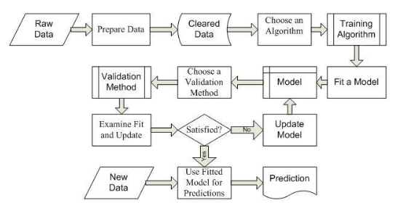
Machine Learning Workflow
Misnevs, B., & Jackiva, I. Y. (2016). Data science: professional requirements and competence evaluation. Baltic Journal of Modern Computing, 4(3), 441.

Slide 35
Where to Then?
These models are not wrong, just not helpful for starting out
Technical skills are non-negotiable in data science
After this class, you will be a much stronger programmer and analyst
You should expect to invest a lot of time in programming and analysis
“Aren’t the themes for each module around a different type of data? Doesn’t that mean this is just another data-centered class?”
How to apply a data science mindset across diverse kinds of data
Building this mindset — rather than specific methods, tools, and models — is the human-centered approach we want you to learn
What is a data science mindset?

Slide 36
Building a Data Science Mindset

Slide 37
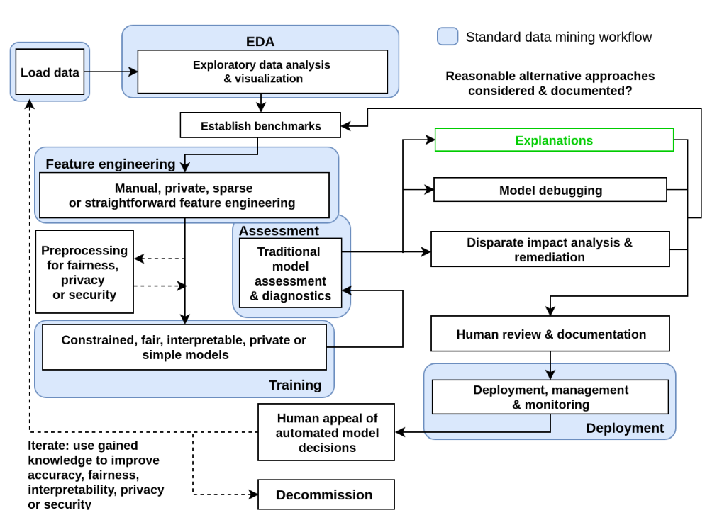

Human-centered data science
Again not wrong, just not helpful
Hall, P. (2019). On Explainable Machine Learning Misconceptions & A More Human-Centered Machine Learning.

Slide 38

Non-Technical Competencies in DS?
Hattingh, M., Marshall, L., Holmner, M., & Naidoo, R. (2019). Data Science Competency in Organisations: A Systematic Review and Unified Model. In Proc. SAICSIT 2019.

Slide 39

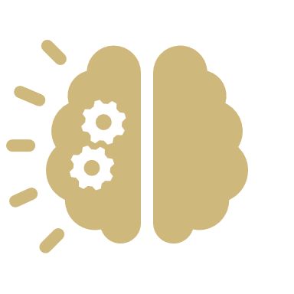


A Modest Proposal
Growth Mindset
Computational Thinking
Hacker Ethic
Scientific Norms

Slide 40
A Modest Proposal
Growth Mindset
Computational Thinking
Hacker Ethic
Scientific Norms

Slide 41
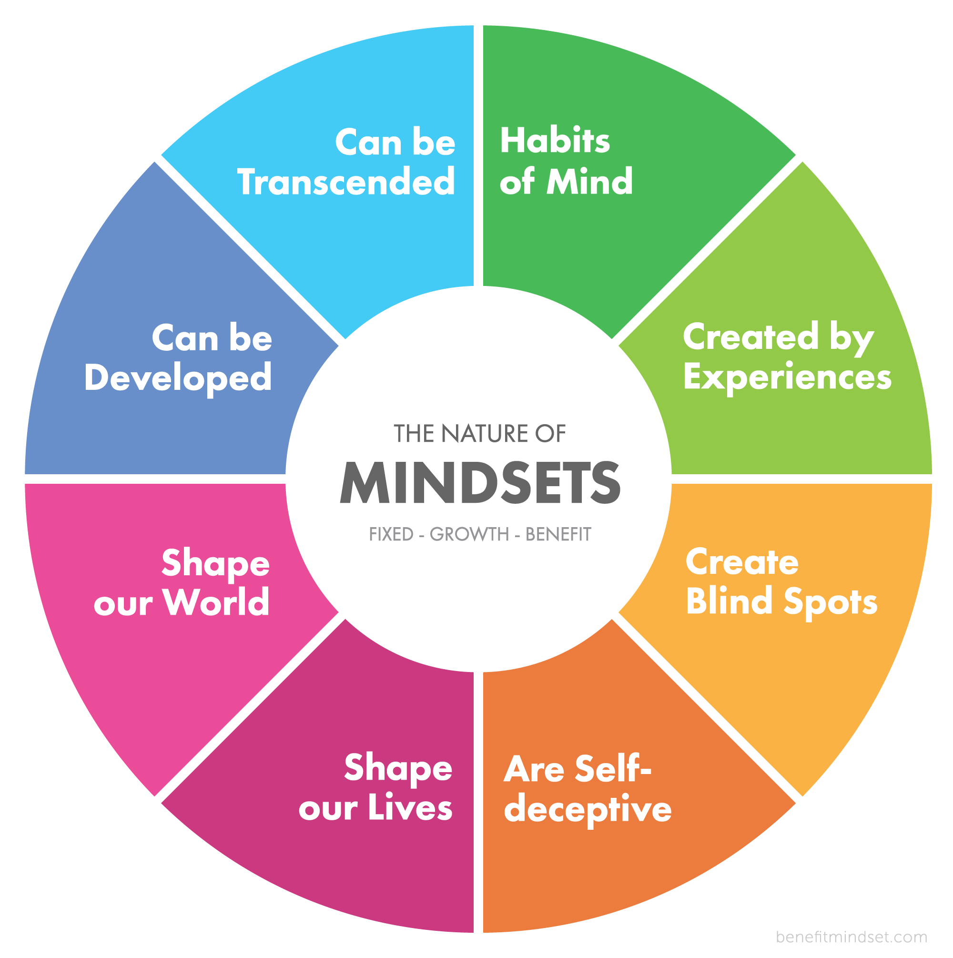
Growth Mindset
Pre-Renaissance: fixed endowments, predetermined positions, ability is heritable, mobility is a threat to social order
Not gone: high-stakes testing used to “discover” ability and to exclude
Early cognitive psychology
Learned helplessness: animals exposed to uncontrollable shocks made little effort to prevent shocks even after they were controllable
Attribution theory: people’s explanations for what happens to them shapes their reactions to future events
Fixed mindset: fears lack of ability, need to prove ability, challenge-avoiding, stereotype belief/threat, mind as a mold
Growth mindset: fears lack of effort, need to improve ability, challenge-seeking, resilience, mind as a muscle
We make these judgments about ourselves and others
Dweck, C. S., & Yeager, D. S. (2019). Mindsets: A View From Two Eras. Perspectives on Psychological Science; Buchanan, A. (2017). The nature of mindsets.

Slide 42
Growth Mindset Questions
How will you challenge yourself today?
What can you learn from a mistake?
Who can you ask for help?
How could you make this more interesting?
What can you do to focus better?
What’s the next challenge to tackle?
What support resources can you find?
What else do you want to learn?

Slide 43
A Modest Proposal
Growth Mindset
Computational Thinking
Hacker Ethic
Scientific Norms

Slide 44
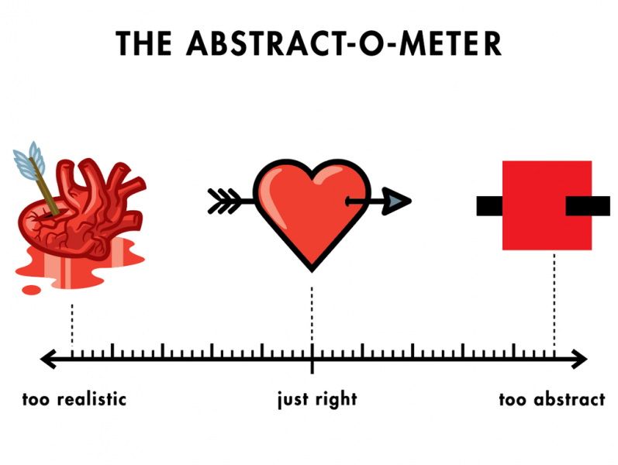
Computational Thinking (CT)
Formulating problems and their solutions that can be executed computationally
Reformulation, recursion, decomposition, abstraction, testing [Wing 2006, Grover & Pea 2013]
Creativity, algorithmic thinking, cooperativity, critical thinking, problem solving [Korkmaz, et al. 2017]
Data practices, simulation, computational problem solving, systems thinking [Weintrop, et al. 2016]
Decomposition, abstraction, algorithms, debugging, iteration, generalization [Shute, et al. 2017]
https://computersciencewiki.org/index.php/File:Abstract_heart.png
Wing, J.M. (2006). Computational thinking. CACM; Grover, S., & Pea, R. (2013). Computational Thinking in K–12. Educational Researcher; Korkmaz, Ö., et al. (2017). A validity and reliability study of the computational thinking scales. Computers in Human Behavior; Shute, V., et al. (2017). Demystifying computational thinking. Educational Research Review; Weintrop, D., et al. (2016). Defining Computational Thinking for Mathematics and Science Classrooms. Journal of Science Education and Technology.

Slide 45
CT Isn’t Just Technical Skills
Concepts: sequences, loops, parallelism, events, conditionals, operators, data
This is what INFO 1201 and 2201 are designed for and INFO 3401 and 3402 will continue to reinforce
Practices
Experimenting and iterating: developing, experimenting, and developing some more
Testing and debugging: making sure things work and solving problems when they arise
Reusing and remixing: building on existing projects or ideas and sharing your own work
Abstracting and modularizing: building something complex by putting together smaller parts
Perspectives
Expressing: computation as a medium for creative and critical expression
Connecting: computation as a tool for of creating for and interacting with others
Questioning: computation as a tool for investigating how the world works
Brennan, K. & Resnick, M. (2012). New Frameworks for Studying and Assessing the Development of Computational Thinking.

Slide 46
A Modest Proposal
Growth Mindset
Computational Thinking
Hacker Ethic
Scientific Norms

Slide 47
Hacker Ethic
“Hacking” as a culture of subverting technical systems not cyber-crime
Common values within hacker ethic [Levy 1984]
Sharing & openness – access to computers/software/data/information should be free and open
Autonomy & meritocracy – hackers should be free to pursue individual goals and judged by their work
Creativity & playfulness – novelty and efficiency; irreverence and references to geek culture
Decentralization & anti-authoritarianism – build technologies to resist bureaucracy and support freedom
Exploring then exploiting opportunities by gaining then using know-how
Moving from curiosity and observation to execution and efficiency
These values emerged from a culture that remains overwhelmingly white and male [Coleman 2012]
Levy, S. (1984). Hackers: Heroes of the computer revolution; Coleman, E.G. (2012). Coding freedom: The ethics and aesthetics of hacking.

Slide 48
The Hacker Attitude
The world is full of fascinating problems waiting to be solved.
“to be a hacker you have to get a basic thrill from solving problems, sharpening your skills, and exercising your intelligence.”
No problem should ever have to be solved twice.
“it's almost a moral duty for you to share information, solve problems and then give the solutions away just so other hackers can solve new problems instead of having to perpetually re-address old ones.”
Boredom and drudgery are evil.
“Hackers should never be bored or have to drudge at stupid repetitive work, because when this happens it means they aren't doing what only they can do — solve new problems.”
Freedom is good.
“[Authoritarians] distrust voluntary cooperation and information-sharing. [Hackers] have to develop an instinctive hostility to censorship, secrecy, and the use of force or deception to compel responsible adults.“
Attitude is no substitute for competence.
“Hackers won't let posers waste their time, but they worship competence... at demanding skills that few can master and skills that involve mental acuteness, craft, and concentration is best.”
Raymond, E.S. (2001). How To Become A Hacker.

Slide 49
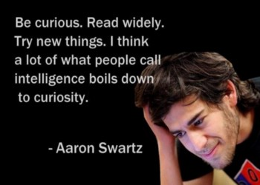
Ten Commandments of Hacker Culture
Give before you get. Horizontal groups, judged on contributions, respect is earned.
Don’t ask for permission. Do things without permission, then evaluate the outcome.
Doing > Talking. Doing creates new solutions and is sign of respect.
No excuses. Hackers are responsible for their actions.
Solve problems. Use creativity to solve problems in new ways.
Follow your curiosity. Hunger for learning and knowing more about topics.
Failing is growing. Grow from overcoming adversity and uncertainty.
Know tools/communities. Don’t reinvent the wheel.
Always be learning. Explore new ideas and experiences.
Get involved. Fix things wrong in the world.
Have fun. Work on projects you care about.
Morato, M. (2015). The Ten Commandments of Hacker Culture.

Slide 50
A Modest Proposal
Growth Mindset
Computational Thinking
Hacker Ethic
Scientific Norms

Slide 51
Scientific Norms
Merton (1942) proposed four norms that guided scientific culture (CUDOS)
Communalism: common ownership of scientific results and methods, duty to share
Universalism: scientific work should be evaluated objectively and impersonally
Disinterestedness: scientific work should be altruistic and avoid self-enrichment and promotion
Organized skepticism: transparency of results, consideration of all evidence, scrutiny by peer review
Widely-criticized and many counter-examples exist, but they remain influential with new norms
Governance: scientists are responsible for direction, control, and self-regulation of science
Quality: scientists judge contributions on the basic of quality not quantity
Calling: science is a higher purpose worthy of sacrificing material benefits
Breadth: scientists fulfill responsibilities like teaching and service in addition to research
Merton, R. K. (1942). A note on science and democracy. J. Legal & Pol. Soc.; Anderson, M. S., et al. (2010). Extending the Mertonian Norms. Journal of Higher Education.

Slide 52
Science as a Profession
Understanding issues of ethics, social responsibility, and awareness of regulations and policies
Privacy, property, accessibility, security, human rights
Communicating results of analyses back to both expert and general audiences
Visualization, evaluation, explanation, trust, persuasion, storytelling
Collaborating to manage complexity and accomplish larger goals
Teamwork, brokerage, delegation, translation, infrastructuring
Management of people and projects
Planning, documentation, leadership, conflict resolution, mentorship, consciousness
Hall, K.L., et al. (2018). The science of team science. American Psychologist; National Academies. (2017). Communicating Science Effectively.

Slide 53
Data Science Mindset Components
Growth Mindset
Computational Thinking
Hacker Ethic
Scientific Norms
Growth Mindset: effort not ability, continual improvement, challenge-seeking, resilience
Computational Thinking: concepts, practices, perspectives of applying computing technologies
Hacker Ethic: sharing, openness, creativity, autonomy, curiosity, bias towards action
Scientific Norms: communalism, skepticism, responsibility, communication, collaboration

Slide 54
Data-centered vs. Human-centered
Do you care more about the data or the people?
 | Data-centered | Human-centered
Who | Unicorn expert-hacker-engineer | Anyone with a question
What | How to do data science | How to be a data scientist
Where | CS, stats, math | INFO, social sciences, real world
When | On the job | As a citizen
Why | Because data can help something | Because data can help someone
How | Life-cycles, frameworks, processes | Context, participation, responsibility

Slide 55
Data Science Mindset Components
Growth Mindset
Computational Thinking
Hacker Ethic
Scientific Norms
Growth Mindset: Monday in-class activity
Computational Thinking: Wednesday pre-class lecture
Hacker Ethic: Wednesday in-class activity
Scientific Norms: Friday in-class activity

Slide 56
Outline
10:20 – 10:25 → Introductions
10:25 – 10:30 → Class norms
10:30 – 10:55 → Mindset exercise
10:55 – 11:05 → Course design questions/input
11:05 – 11:10 → Wrap-up, next class

Slide 57
In-Class

Slide 58
Outline
10:20 – 10:25 → Introductions
10:25 – 10:30 → Class norms
10:30 – 10:55 → Mindset exercise
10:55 – 11:05 → Course design questions/input
11:05 – 11:10 → Wrap-up, next class

Slide 59
Class Norms: Flipped Classroom
Step 1: Watch the pre-recorded lecture posted to Canvas before class
No more than 50 minutes long, sometimes with exercises for you to do before class
Step 2: Log in to Zoom from 10:20am – 11:10am on Mondays, Wednesdays, and Fridays
Using class time for activities, discussions, experiments, guest lectures
Step 3: Complete assigned readings before Friday quiz
Quizzes are a low-stakes but extrinsic motivator for you to keep up with readings and lectures
“Doesn’t this mean we have to spend twice as much in lecture?”
No, it means you have fewer readings and we’re making the most of valuable class time together.
“What’s the point of watching pre-recorded lectures if I can’t ask questions?”
The in-class activities will be designed to explore questions, ideas, and skills from pre-recorded lectures.

Slide 60
Class Norms: Zoom Etiquette
Neither Dr. Handler nor Dr. Keegan taught in Spring 2020, so this is our first remote class
Zoom meeting for each class will be recorded and posted to Canvas
Participants will be muted by default and should use “Raise Hand” to be called on
Video should be on, please have non-distracting clothes and background
Context switching (Zoom ⟷ Jupyter) will be necessary, but please no background browsing
Use public chat for questions and comments, but don’t use private chat for side conversations
We will experiment with breakout rooms, whiteboard, annotate, polling and other functions
Disruptive behavior will get a single warning before being kicked and losing day’s participation
What are other norms and lessons to incorporate from your experiences in other classes?

Slide 61
Introductions
We’ll do approximately a third of a class each day this week
Name
Year
Major(s) and minor(s)
Greatest achievement since spring semester
Career interests

Slide 62
Course overview
There
will be
class on the Monday and Wednesday of Thanksgiving week

Slide 63
Readings
Required – expect to be on a quiz
PDFs of full books on Canvas – these are very short blog-length chapters.
Leek, J. (2015). The Elements of Data Analytic Style. Chapters 1, 2.
Peng, R.D. & Matsui, E. (2018). The Art of Data Science. Chapters 1, 2, 3.
Wilcom, “A Beginner’s Guide to Using Developer Documentation Like a Pro.”
Optional – won’t be on a quiz but may be a part of lecture, class, notebooks, etc.
Tukey, J.W. (1962). “The Future of Data Analysis.” Annals of Mathematical Statistics.
Cleveland, W.S. (2001). “Data science: An action plan for expanding the technical areas of the field of statistics.” International Statistical Review.
Tufte, E. (2016). “The Future of Data Analysis.” Microsoft Machine Learning & Data Science Summit.
Donoho, D. (2017). “50 Years of Data Science.” J. of Computational and Graphical Statistics.
McNichol, D. (2017). “The Many Futures of Data Analysis.” Towards Data Science.

Slide 64
Data-centered vs. Human-centered
Do you care more about the data or the people?
>90% of data science education focuses on data-centered perspectives
 | Data-centered | Human-centered
Who | Unicorn expert-hacker-engineer | Anyone with a question
What | How to do data science | How to be a data scientist
Where | CS, stats, math | INFO, social sciences, real world
When | On the job | As a citizen
Why | Because data can help something | Because data can help someone
How | Life-cycles, frameworks, processes | Context, participation, responsibility

Slide 65
Data Science Mindset Components
Growth Mindset
Computational Thinking
Hacker Ethic
Scientific Norms
Growth Mindset: effort not ability, continual improvement, challenge-seeking, resilience
Computational Thinking: concepts, practices, perspectives of applying computing technologies
Hacker Ethic: sharing, openness, creativity, autonomy, curiosity, bias towards action
Scientific Norms: communalism, skepticism, responsibility, communication, collaboration

Slide 66
Course Design Questions and Input
What are your goals for INFO 3402?
Learning a specific topic, improving skills, developing a portfolio, etc.
Think about INFO 1111, 1121, 1201, 2201, 2301
What elements of these courses' designs should we try to incorporate—or avoid—for 3402?
What are other questions you have about our proposed design of INFO 3401?
Go back to lecture and syllabus

Slide 67
Growth Mindset
Fixed mindset: fears lack of ability, need to prove ability, challenge-avoiding, stereotype belief/threat, mind as a mold
Growth mindset: fears lack of effort, need to improve ability, challenge-seeking, resilience, mind as a muscle
Dweck, C. S., & Yeager, D. S. (2019). Mindsets: A View From Two Eras. Perspectives on Psychological Science; Buchanan, A. (2017). The nature of mindsets.

Slide 68
Mindset Exercise
Discuss a time when you overcame a struggle and learned to solve a hard problem.
Academic, athletic, hobby, etc.
What helped you overcome this struggle?
Personal effort?
Using another perspective?
Confronting a fear?
Internal or external goals?
Support from others?
Take 3 minutes to think about it for yourself and then ~5 people will share out

Slide 69
Module Assignment 0
Required assignment, will be lightly graded (will receive full credit for good-faith effort)
https://canvas.colorado.edu/courses/62560/assignments/765480
Write a letter to a future student of this class
At least one five-sentence paragraph about each of these:
The academic challenges you’ve faced so far in college
Your worries about taking this class
An example of a time when you overcame a struggle to learn something
Advice on what to do they next time they encounter an obstacle when learning something new
Text document (.doc, .docx, .txt, .pdf) due by 10 am, Wednesday, September 2 on Canvas

Slide 70
Next classes
Wednesday: Computational practices, hacker ethic, COVID-19 manifestos
Friday: Scientific norms, continue the COVID-19 data manifestos
Readings (on Canvas)
Leek, Elements of Data Analytic Style, Ch. 1, 2, (very short chapters!)
Peng & Matsui, Art of Data Science, Ch. 1, 2, 3
Wilcom, “A Beginner’s Guide to Using Developer Documentation Like a Pro.”
Other documentation, tutorials, and resources available on Canvas

